Slide 1
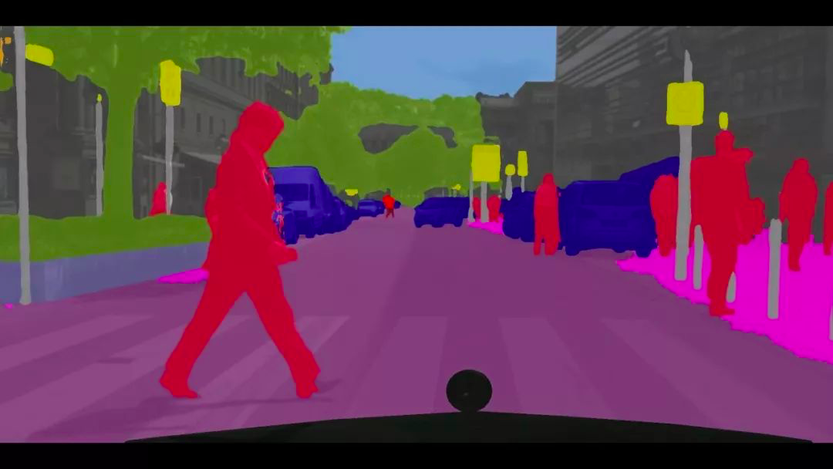
Image Segmentation by Local Entropy Methods
Authors:
3rd year(Friday) Duisenova Aidana-researcher
3rd year(Friday) Aitbanov Abylai-coder

Slide 2
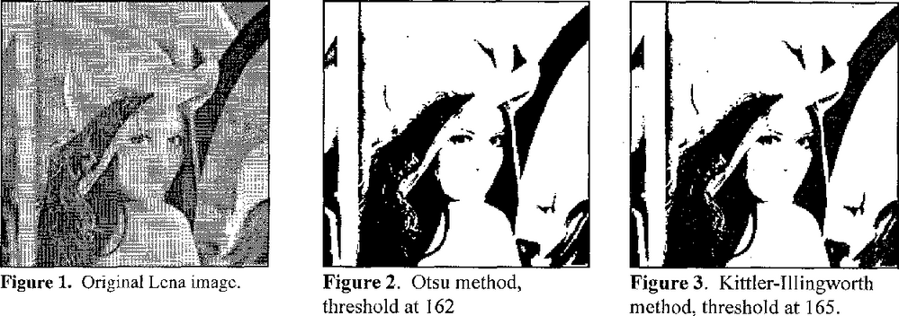
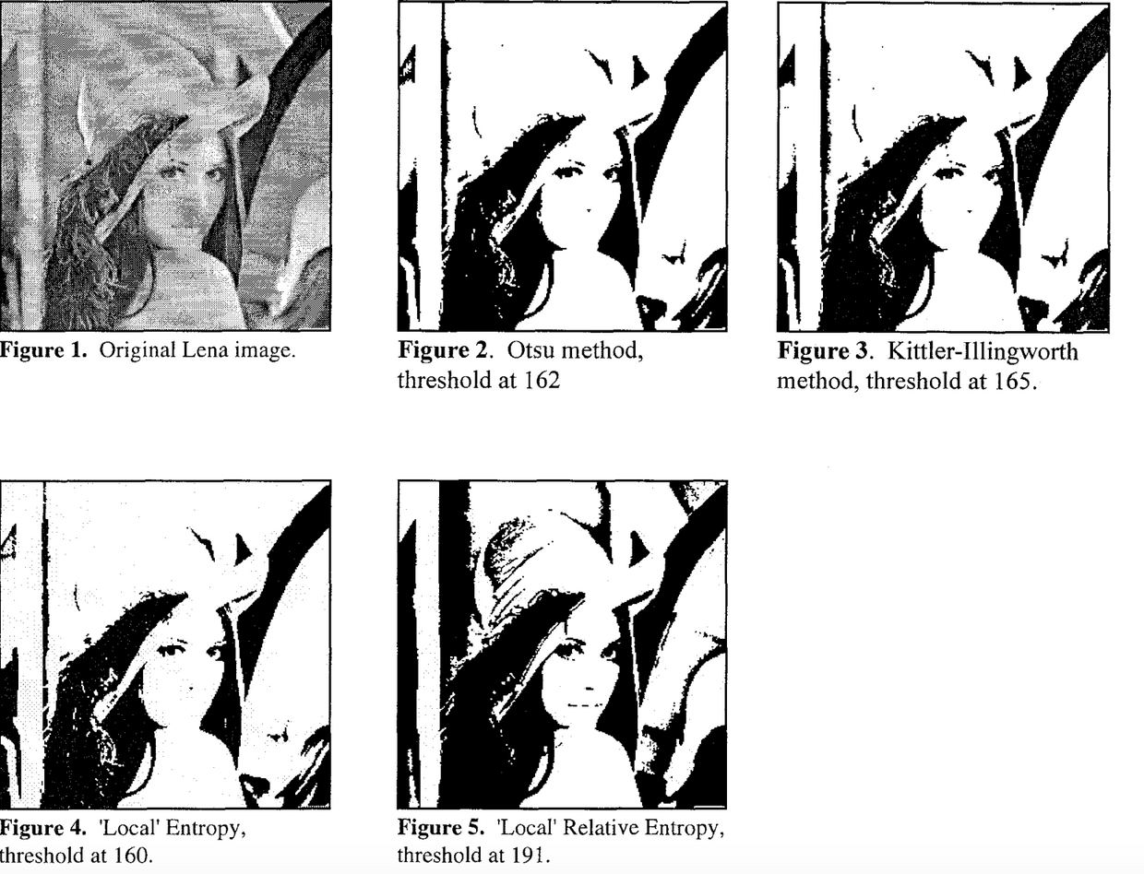
Relevance
The Problem of the research
In this article, we are expanding the entropy thresholding methods and describe local entropy and local relative entropy thresholding methods and compare them to two studied methods from the literature, those of Kittler and Illingworth and of Otsu.

Slide 3
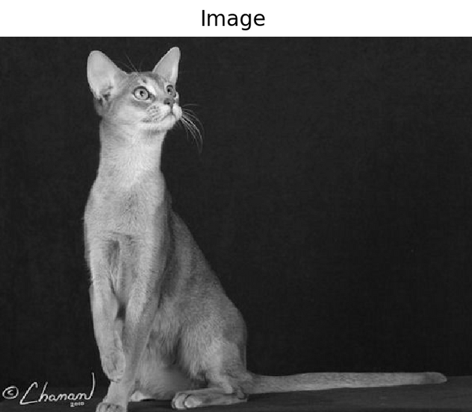

What is Image Segmentation?
Image Segmentation is essentially the process of partitioning a digital image into multiple segments to simplify and/or change the representation of an image into something that is more meaningful and easier to analyze.

Slide 4
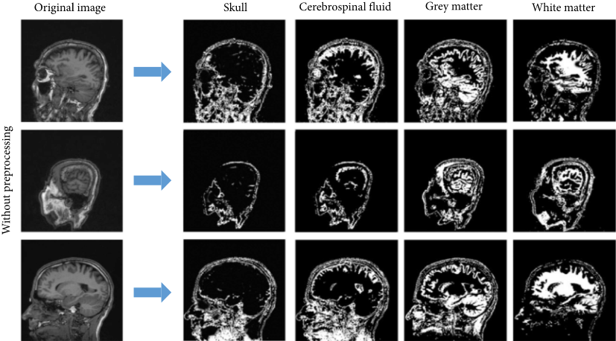
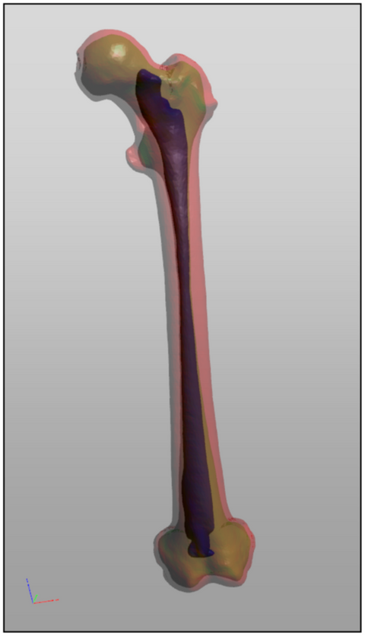
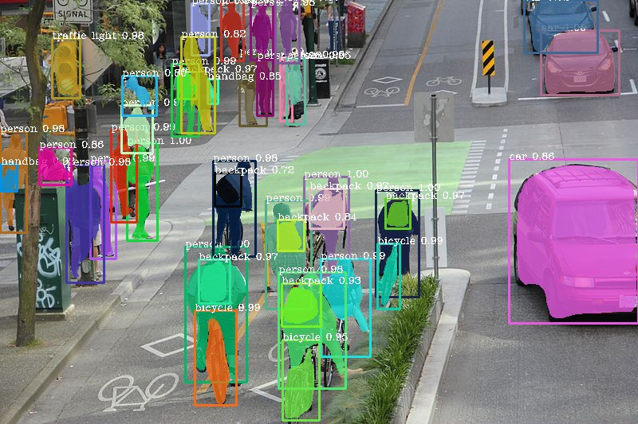
How much research is in demand?
Some practical uses for image segmentation are:
Detection of tumors and other pathologies
Determination of tissue volumes
Computer-assisted surgery
Diagnostics
Treatment planning
Study of the anatomical structure
Highlighting objects in satellite images
Face recognition
Fingerprint recognition
Traffic management systems
Brake light detection
Machine vision
Parallelization of information streams when transmitting high-resolution images

Slide 5
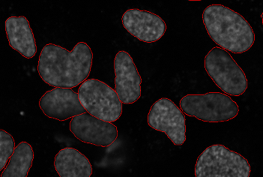
Cancer has long been a deadly illness. Even in today’s age of technological advancements, cancer can be fatal if we don’t identify it at an early stage. Detecting cancerous cell(s) as quickly as possible can potentially save millions of lives.
The shape of the cancerous cells plays a vital role in determining the severity of the cancer. Image Segmentation techniques make a MASSIVE impact here. They help us approach this problem in a more granular manner and get more meaningful results. A win-win for everyone in the healthcare industry.
Here, we can clearly see the shapes of all the cancerous cells

Slide 6
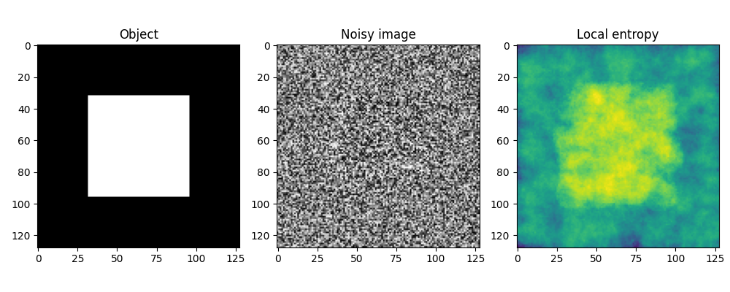
How much research is related to the subject of information theory ?
Entropy
In information theory, information entropy is the log-base-2 of the number of possible outcomes for a message.
For an image, local entropy is related to the complexity contained in a given neighborhood, typically defined by a structuring element. The entropy filter can detect subtle variations in the local gray level distribution.

Slide 7
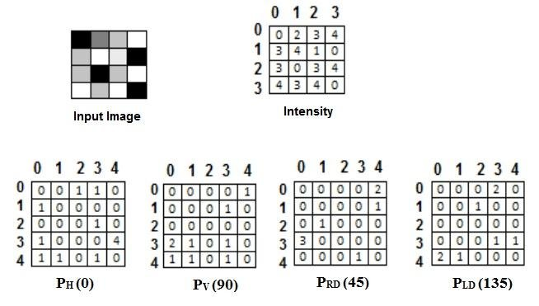
Main Models of Information
THRESHOLDING METHODS
To provide the probability
distribution needed for the entropy measures, a co-occurrence matrix is generated from the input image.The candidate threshold divides the co-occurrence matrix into four regions representing within object, within
background, object to background, and background to
object class transitions. Three entropies, called local,
joint, and global, are computed by differing
comlbinations of the entropies of this four regions

Slide 8
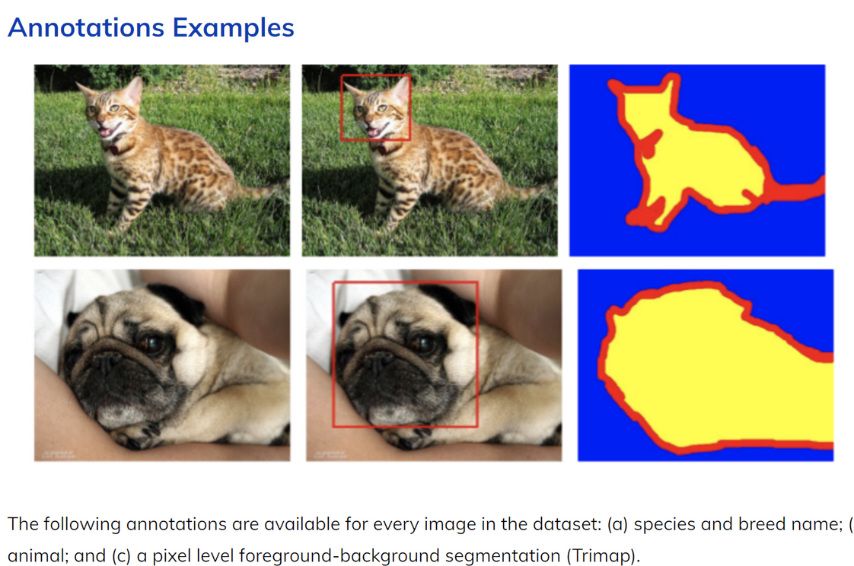
Datasets

Slide 9

The Plan
STEP 1(18.10.21)
STEP 2(25.10.21)
STEP 3(1.11.21)
Go deeper in understanding theoretical concepts of image processing and segmentation
Write brief algorithms to get result(Unsupervised segmentation)
Get a dataset from "The Oxford-IIIT Pet Dataset",
prepare some algorithms.
STEP 4(8.11.21)
STEP 5(15.11.21)
STEP 6(22.11.21)
Make tests of algorithms
Apply the written algorithms(Supervised segmentation)
Make a conclusion and write report

Slide 10

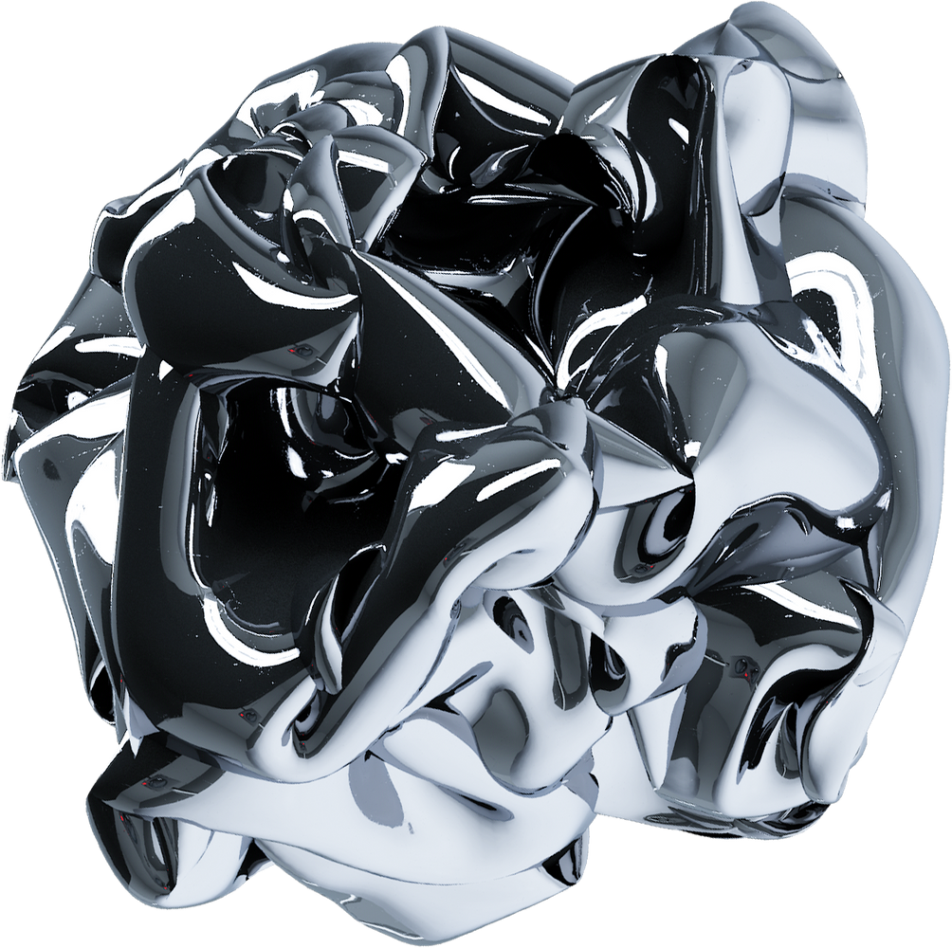

Thank you for your attention!

